Slide 1
Public Health Merit Badge
Troop 344 and 9344
Pemberville, OH

Slide 2
Public Health
Requirements
Do the following:
Explain what public health is. Explain how Escherichia coli (E. coli), tetanus, HIV/AIDS, malaria, salmonellosis, and Lyme disease are contracted.
Choose any FOUR of the following diseases or conditions, and explain how each one is contracted and possibly prevented: gonorrhea, West Nile virus, Zika, botulism, influenza, syphilis, hepatitis, emphysema, meningitis, herpes, lead poisoning.
For each disease or condition in requirement 1b, explain:
The type or form of the malady (viral, bacterial, environmental, toxin)
Any possible vectors for transmission
Ways to help prevent exposure or the spread of infection
Available treatments

Slide 3
Public Health
Requirements
Do the following:
Explain the meaning of immunization.
Name eight diseases against which a young child should be immunized, two diseases against which everyone should be re-immunized periodically, and one immunization everyone should receive annually.
Using the list of diseases and conditions in requirement 1b, discuss with your counselor those which currently have no immunization available.

Slide 4
Public Health
Requirements
Discuss the importance of safe drinking water in terms of the spread of disease. Then, demonstrate two ways for making water safe to drink that can be used while at camp. In your demonstration, explain how dishes and utensils should be washed, dried, and kept sanitary at home and in camp.
Explain what a vector is and how insects and rodents can be controlled in your home, in your community, and at camp. Tell why this is important. In your discussion, explain which vectors can be easily controlled by individuals and which ones require long-term, collective action.

Slide 5
Public Health
Requirements
With your parent's and counselor's approval, do ONE of the following:
Visit a municipal wastewater treatment facility OR a solid-waste management operation in your community.
Describe how the facility safely treats and disposes of sewage or solid waste.
Discuss your visit and what you learned with your counselor.
Describe how sewage and solid waste should be disposed of under wilderness camping conditions.

Slide 6
Public Health
Requirements
With your parent's and counselor's approval, do ONE of the following:
Visit a food service facility, such as a restaurant or school cafeteria.
Observe food preparation, handling, and storage. Learn how the facility keeps food from becoming contaminated.
Find out what conditions allow micro-organisms to multiply in food, what can be done to help prevent them from growing and spreading, and how to kill them.
Discuss the importance of using a thermometer to check food temperatures.
Discuss your visit and what you learned with your counselor.

Slide 7
Public Health
Requirements
Do the following:
Describe the health dangers from air, water, and noise pollution.
Describe health dangers from tobacco use and alcohol and drug abuse.
Describe the health dangers from abusing illegal and prescription drugs.
With your parent's and counselor's approval, do ONE of the following:
Visit your city, county, or state public health agency.
Familiarize yourself with your city, county, or state health agency's website.

Slide 8
Public Health
Requirements
After completing either 7a or 7b, do the following:
Compare the four leading causes of mortality (death) in your community for any of the past five years with the four leading causes of disease in your community. Explain how the public health agency you visited is trying to reduce the mortality and morbidity rates of these leading causes of illness and death.
Explain the role of your health agency as it relates to the outbreak of diseases.
Discuss the kinds of public assistance the agency is able to provide in case of disasters such as floods, storms, tornadoes, earthquakes, and other acts of destruction. Your discussion can include the cleanup necessary after the disaster.
Pick a profession in the public health sector that interests you. Find out the education, training, and experience required to work in this profession. Discuss what you learn with your counselor.

Slide 9
Requirement 1
Do the following:
Explain what public health is. Explain how Escherichia coli (E. coli), tetanus, HIV/AIDS, malaria, salmonellosis, and Lyme disease are contracted.
Choose any FOUR of the following diseases or conditions, and explain how each one is contracted and possibly prevented: gonorrhea, West Nile virus, Zika, botulism, influenza, syphilis, hepatitis, emphysema, meningitis, herpes, lead poisoning.
For each disease or condition in requirement 1b, explain:
The type or form of the malady (viral, bacterial, environmental, toxin)
Any possible vectors for transmission
Ways to help prevent exposure or the spread of infection
Available treatments

Slide 10
Requirement 1a
What is Public Health?
Public health is the science of protecting and improving the health of people and their communities. This work is achieved by promoting healthy lifestyles, researching disease and injury prevention, and detecting, preventing and responding to infectious diseases.

Slide 11
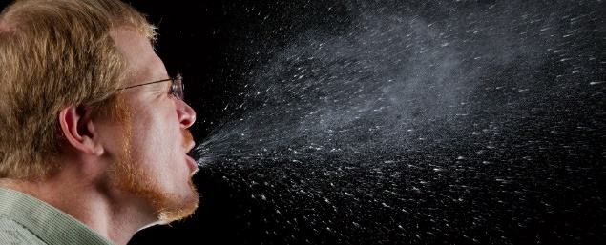
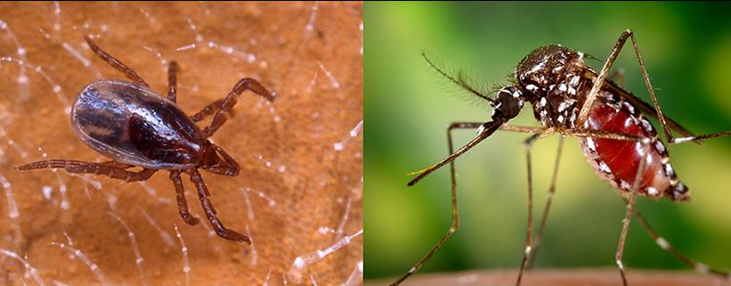
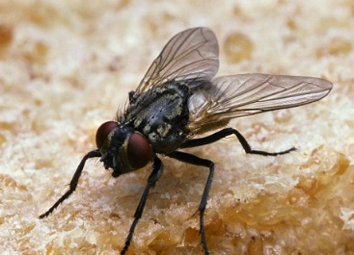
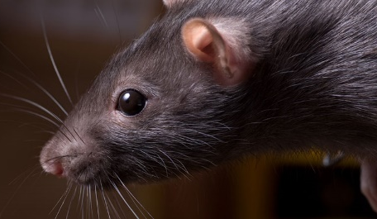
Requirement 1a
Knowing how diseases can be spread is key to prevention.
Aerosol/droplets
Direct contact
Contaminated water
Contaminated food
Vectors (Organisms which carry and transmit an infectious pathogen into another living organism.)

Slide 12
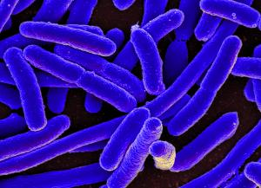
Requirement 1a
Escherichia coli (E. coli)
E. coli is one of the most common bacteria found in human and animal digestive systems
It’s benefits to us include the production of vitamin K (helps blood clotting) and by preventing other dangerous germs to grow in our guts.

Slide 13
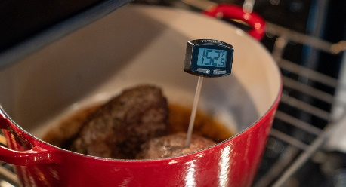
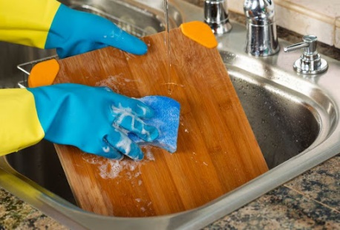
Requirement 1a
Escherichia coli (E. coli)
However, some strains can produce toxins that can make us sick or cause death.
Occasionally during food preparation our food becomes contaminated with “bad” E. coli.
If the food is not cooked properly, we ingest these germs and they cause illness.
They can also be acquired by swallowing contaminated swimming water.

Slide 14
Requirement 1a
Pathogenic E. coli
Type or Form | Bacteria
Method of Transmission or Vectors | Eating food contaminated with animal feces. No animal vectors.
Methods of Prevention | Wash your hands thoroughly before preparing food!! Wash vegetable produce before serving. Keep meats away from foods that won’t be cooked. Cook ground or tenderized meats to an internal temperature of 160ºF.
Available Treatments | Supportive care, including hydration. Antibiotics and anti-diarrheal drugs should not be used as they increase the risk of complications.

Slide 15
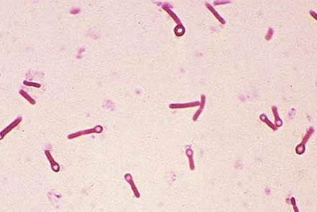
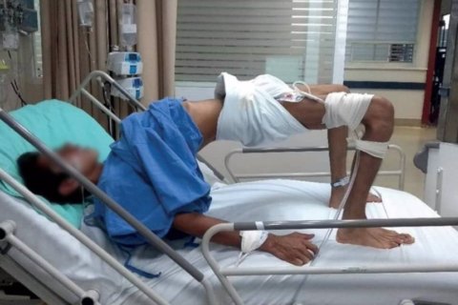
Requirement 1a
Tetanus
Also known as lockjaw, is caused by a toxin produced by the bacteria Clostridium tetani.
C. tetani is a common environmental bacteria found in soil, especially current or former farm lands.
Characteristic symptoms include sever muscle pain and stiffness, difficulty swallowing, muscle spasms (strong enough to break bones).

Slide 16
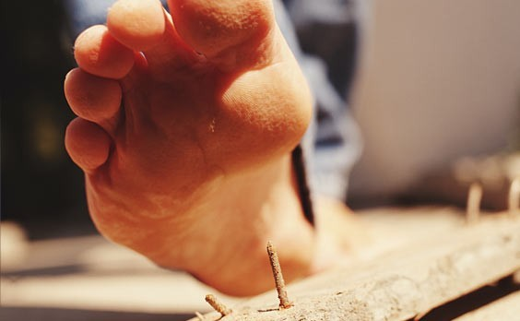
Requirement 1a
Tetanus
Commonly associated with rusty nails.
It is not the rust that causes tetanus, but the dirt and low oxygen environment of the rust that provides a place for the germs to hide.
10% to 20% of those infected die.

Slide 17
Requirement 1a
Tetanus
Type or Form | Bacteria
Method of Transmission or Vectors | Puncture wounds from dirty objects. No animal vectors.
Methods of Prevention | Vaccination available. Booster shots every 10 years for adults. If you suffer a deep puncture wound, apply appropriate first-aid and follow up with a doctor. Wear shoes!
Available Treatments | Tetanus antitoxin. Antibiotics.

Slide 18
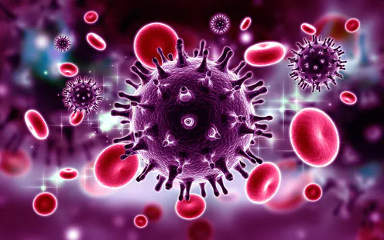
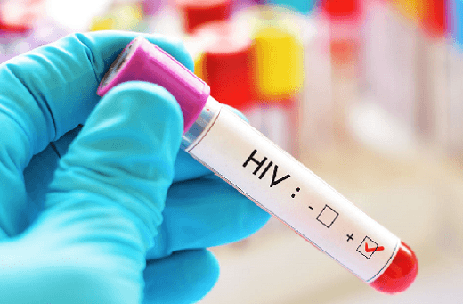
Requirement 1a
HIV/AIDS
Caused by the Human Immunodeficiency Virus.
The virus replicates itself inside the human white blood cells responsible for controlling our immune systems.
When the virus destroys enough cells over time, our immune system fails.
Patients become very susceptible to opportunistic infections.

Slide 19
Requirement 1a

Slide 20
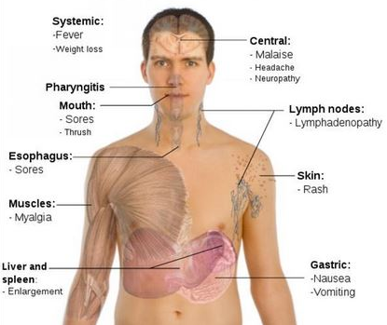
Requirement 1a
Main Symptoms of Acute HIV Infection

Slide 21
Requirement 1a
HIV/AIDS
Type or Form | Virus
Method of Transmission or Vectors | Direct contact with human bodily fluids. No animal vectors.
Methods of Prevention | Safe sex practices or abstinence. Don’t use illicit drugs. Substance abusers should take advantage of needle exchange programs. Health care workers need to wear personal protection equipment. Testing of blood/organs before transfusion/transplants.
Available Treatments | No vaccine, no cure. Antiviral drugs can slow progress of disease. Treatment of opportunistic infections.

Slide 22
Requirement 1a
Malaria is a mosquito-borne disease caused by a parasite.
People with malaria often experience fever, chills, and flu-like illness.
Left untreated, they may develop severe complications and die.
In 2018 an estimated 228 million cases of malaria occurred worldwide and 405,000 people died, mostly children in the African Region.
About 2,000 cases of malaria are diagnosed in the United States each year.
The vast majority of cases in the United States are in travelers and immigrants returning from countries where malaria transmission occurs.

Slide 23
Requirement 1a
Malaria
Type or Form | Parasitic protozoan (Plasmodim sp.)
Method of Transmission or Vectors | Mosquitoes
Methods of Prevention | Control mosquitoes. Use insect repellant with DEET. Sleeping under mosquito netting. Antimalarial medicines can also be used to prevent malaria.
Available Treatments | Antimalarial medicines.

Slide 24
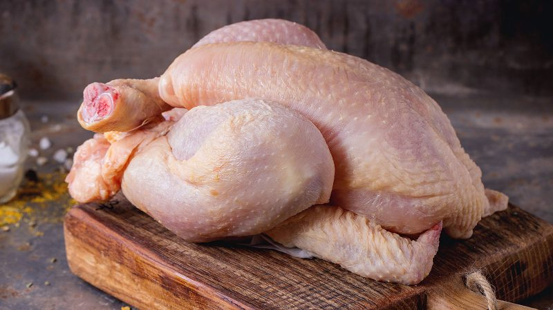
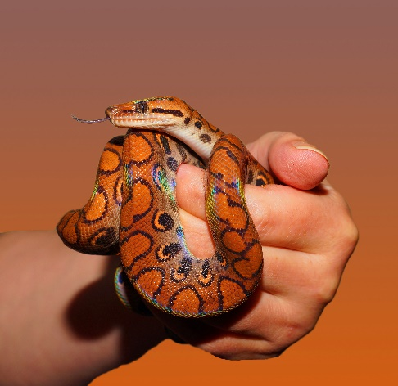
Requirement 1a
Salmonellosis
Caused by the bacteria Salmonella.
Infection occurs by ingesting food products contaminated with Salmonella
Symptoms occur 12 to 72 hours after consuming contaminated food and includes vomiting and diarrhea.
In children, elderly, and persons with weakened immune systems, severity of the infection can cause death.
Contamination usually occurs during food handling and preparation.
The bacteria are common on reptiles, amphibians, rodents, and birds (chicken).

Slide 25
Requirement 1a
Salmonella
Type or Form | Bacteria
Method of Transmission or Vectors | Eating foods contaminated with feces from an infected animal. No animal vectors.
Methods of Prevention | Wash your hands thoroughly before preparing food!! Wash vegetable produce before serving. Keep meats away from foods that won’t be cooked. Cook ground or tenderized meats to an internal temperature of 160ºF.
Available Treatments | Supportive care, including hydration. Antibiotics and anti-diarrheal drugs should not be used as they increase the risk of complications.

Slide 26
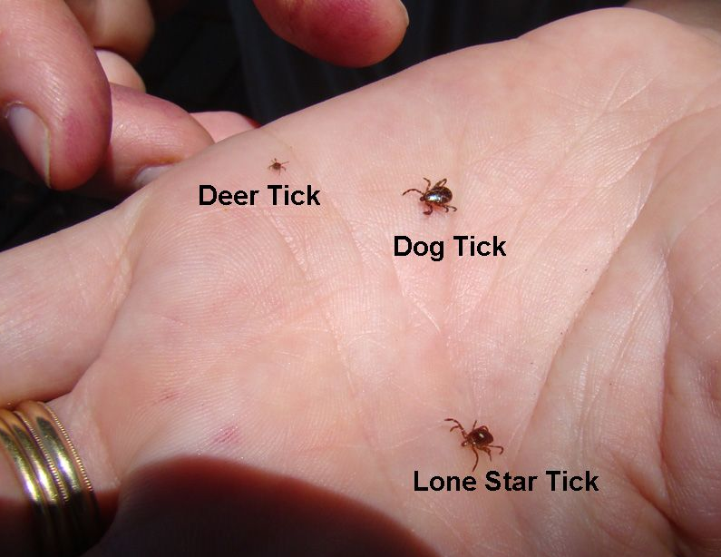
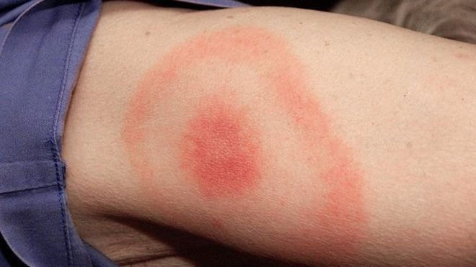
Requirement 1a
Lyme Disease
Caused by bacteria transmitted by the deer tick.
Symptoms can include chills and fever, headache, fatigue, stiff neck, muscle and/or joint pain, and swollen glands.
A bull’s eye rash is typical in many cases.

Slide 27
Requirement 1a
Lyme Disease
Type or Form | Bacteria
Method of Transmission or Vectors | Deer Tick (Ixodes scapularis) Also called Blacklegged Tick
Methods of Prevention | In tick areas: Wear light colored clothing. Use insect repellents with DEET. Check your body for ticks and remove within 24 hours. Know how to properly remove a tick if you are bitten.
Available Treatments | Antibiotics

Slide 28
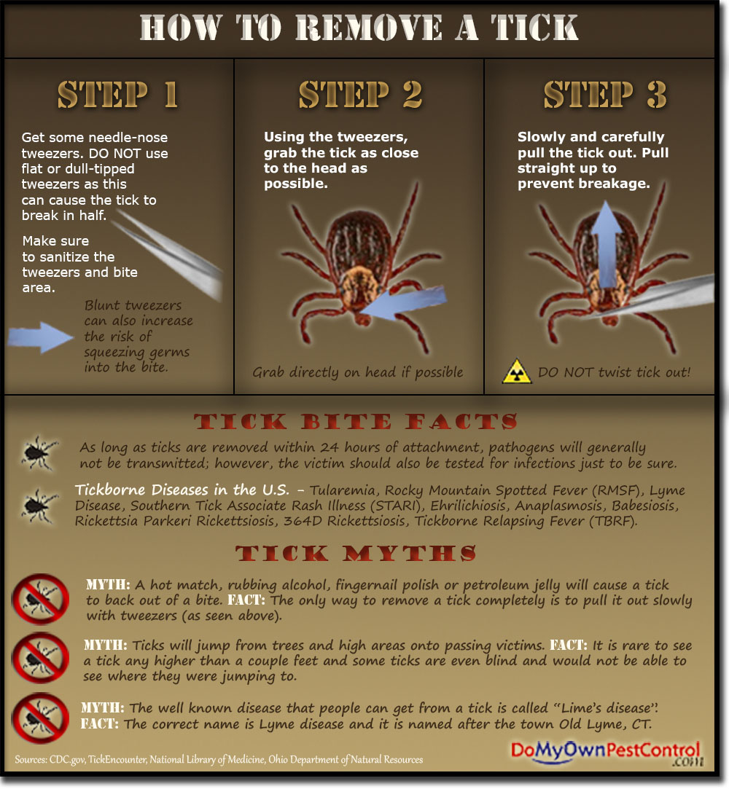
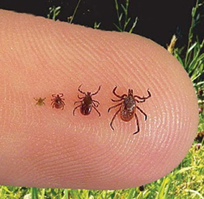
Requirement 1a
Nymph ticks are actually the most likely to transmit Lyme disease or another tick-borne infection to humans than ticks at other stages. Less than two millimeters in size, nymphs can bite people and remain virtually undetected.

Slide 29
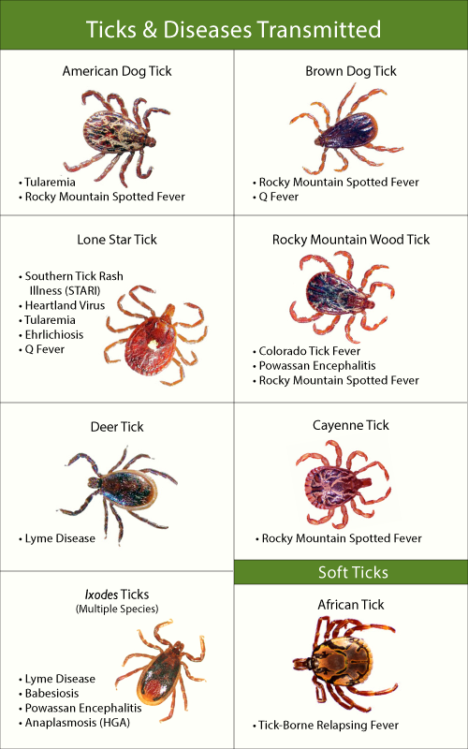
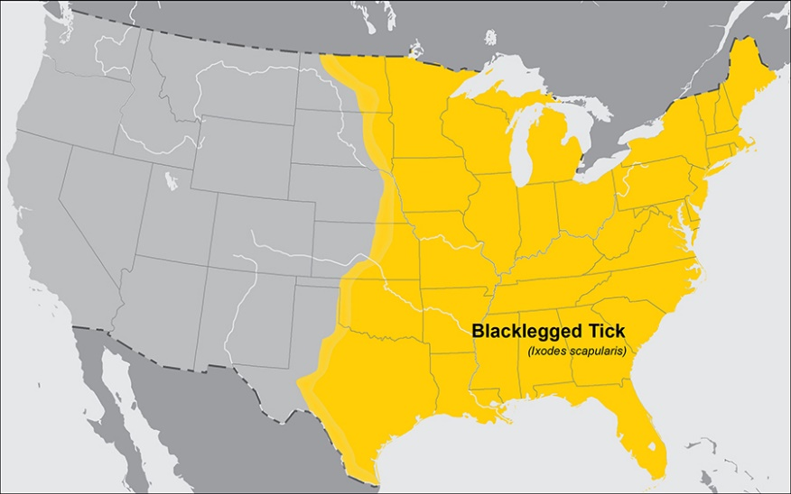
Requirement 1a

Slide 30
Requirement 1
Do the following:
Explain what public health is. Explain how Escherichia coli (E. coli), tetanus, HIV/AIDS, malaria, salmonellosis, and Lyme disease are contracted.
Choose any FOUR of the following diseases or conditions, and explain how each one is contracted and possibly prevented: gonorrhea, West Nile virus, Zika, botulism, influenza, syphilis, hepatitis, emphysema, meningitis, herpes, lead poisoning.
For each disease or condition in requirement 1b, explain:
The type or form of the malady (viral, bacterial, environmental, toxin)
Any possible vectors for transmission
Ways to help prevent exposure or the spread of infection
Available treatments

Slide 31
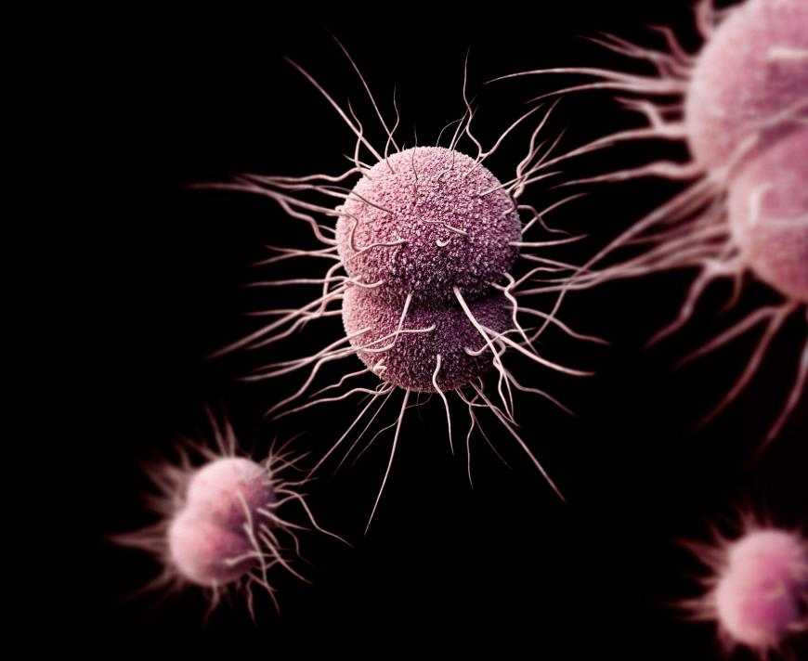
Requirement 1b
Gonorrhea
Type or Form | Bacteria
Method of Transmission or Vectors | Sexually transmitted disease (STD). No animal vectors.
Methods of Prevention | Abstinence Safe sex practices
Available Treatments | Antibiotics

Slide 32
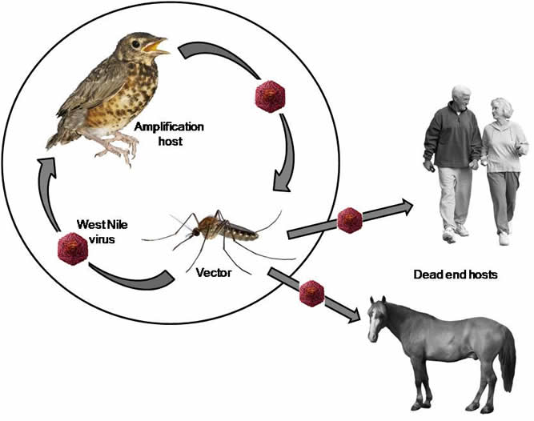
Requirement 1b
West Nile Virus
Type or Form | Virus
Method of Transmission or Vectors | Mosquitoes transmit virus from birds.
Methods of Prevention | Eliminate stagnant water sources. Use insect repellent
Available Treatments | No disease treatment. Supportive care.
Symptoms and signs of West Nile virus include fever, headache, body aches, skin rash, and swollen lymph nodes. Most cases of West Nile virus infection are mild and go unreported.

Slide 33
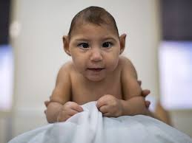
Requirement 1b
Zika
Type or Form | Virus
Method of Transmission or Vectors | Mosquitoes
Methods of Prevention | Eliminate stagnant water sources. Use insect repellent
Available Treatments | No disease treatment. Supportive care.
In most cases, there are no symptoms. In a few cases, Zika can trigger paralysis (Guillain-Barré Syndrome). In pregnant women, it may cause subsequent birth defects.
When present, symptoms are mild and last less than a week. They include fever, rash, joint pain, and red eyes.

Slide 34
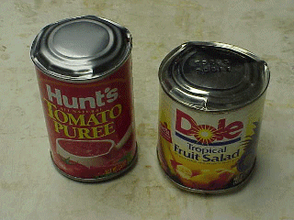
Requirement 1b
Botulism
Type or Form | Bacteria toxin
Method of Transmission or Vectors | Food borne botulism: Humans come into contact with botulism by eating improperly canned or preserved foods that contain the botulinum toxin. Wound botulism : Humans come into contact with botulism when a wound is infected with bacteria. No animal vectors.
Methods of Prevention | Safe food handling. Proper wound care.
Available Treatments | Antitoxin Supportive care Antibiotics

Slide 35
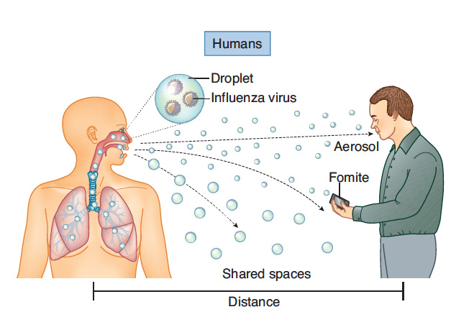
Requirement 1b
Influenza
Type or Form | Virus
Method of Transmission or Vectors | Person-to-person Aerosol/droplet. No animal vectors.
Methods of Prevention | Hand washing. Social distancing.
Available Treatments | Supportive care. Antiviral therapies.
Every year in the United States, on average:
5% to 20% of the population gets the flu.
More than 200,000 people are hospitalized from flu-related complications.
About 36,000 people die from flu-related causes.

Slide 36
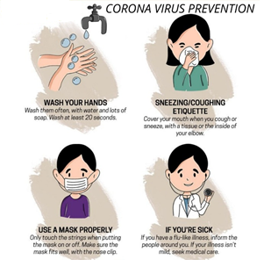
Requirement 1b
Corona Virus
Type or Form | Virus
Method of Transmission or Vectors | Person-to-person. Aerosol/droplet. No animal vectors.
Methods of Prevention | Hand washing. Social distancing.
Available Treatments | Supportive care.
The coronavirus (COVID‑19), causes severe acute respiratory problems. The World Health Organization declared the outbreak a pandemic on March 11, 2020. As of May 19, 2020, more than 4.86 million cases of COVID-19 have been reported in more than 188 countries and territories, resulting in more than 321,000 deaths. More than 1.66 million people have recovered from the virus.

Slide 37
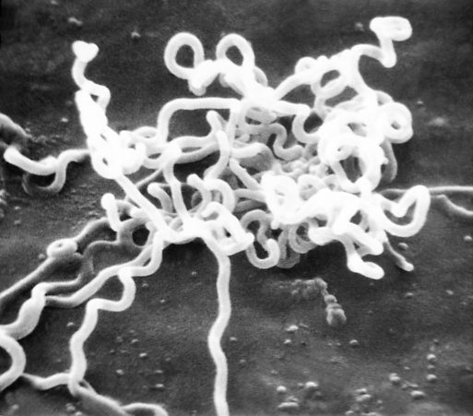
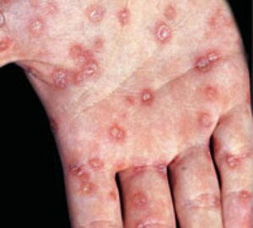
Requirement 1b
Syphilis
Type or Form | Bacteria
Method of Transmission or Vectors | Sexually transmitted disease (STD). No animal vectors.
Methods of Prevention | Abstinence. Safe sex practices.
Available Treatments | Antibiotics.

Slide 38
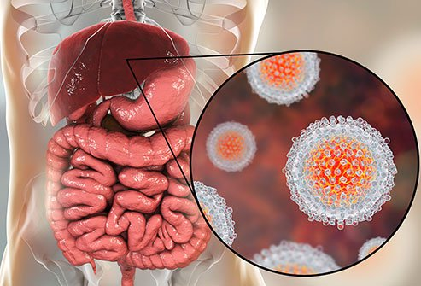
Requirement 1b
Hepatitis
Type or Form | Viruses
Method of Transmission or Vectors | Blood borne pathogen. Foodborne illness. No animal vectors.
Methods of Prevention | Blood and body fluid precautions. Proper food handling/hygiene. Vaccination. No animal vectors.
Available Treatments | Antiviral therapies. Supportive care.
Hepatitis refers to an inflammatory condition of the liver. It's commonly caused by a viral infection,

Slide 39
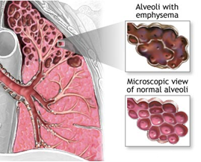
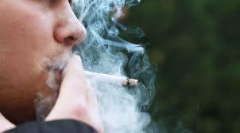
Requirement 1b
Emphysema
Type or Form | Environmental
Method of Transmission or Vectors | Chronic exposure to toxic chemicals such as long-term smoking. No animal vectors.
Methods of Prevention | Don’t smoke. Avoid second-hand smoke.
Available Treatments | No cure. Supportive/comfort care until death. Lung transplants.

Slide 40
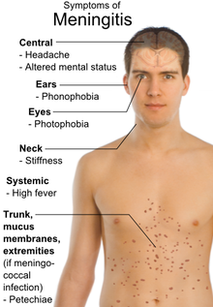
Requirement 1b
Meningitis
Type or Form | Bacteria or virus
Method of Transmission or Vectors | Person-to-person. No animal vectors.
Methods of Prevention | Vaccination. Isolation/quarantine.
Available Treatments | Bacterial – Antibiotics. Viral – Usually self-limiting*. Supportive care.
*Self-limiting: They last a while and then go away as your body fights them.

Slide 41
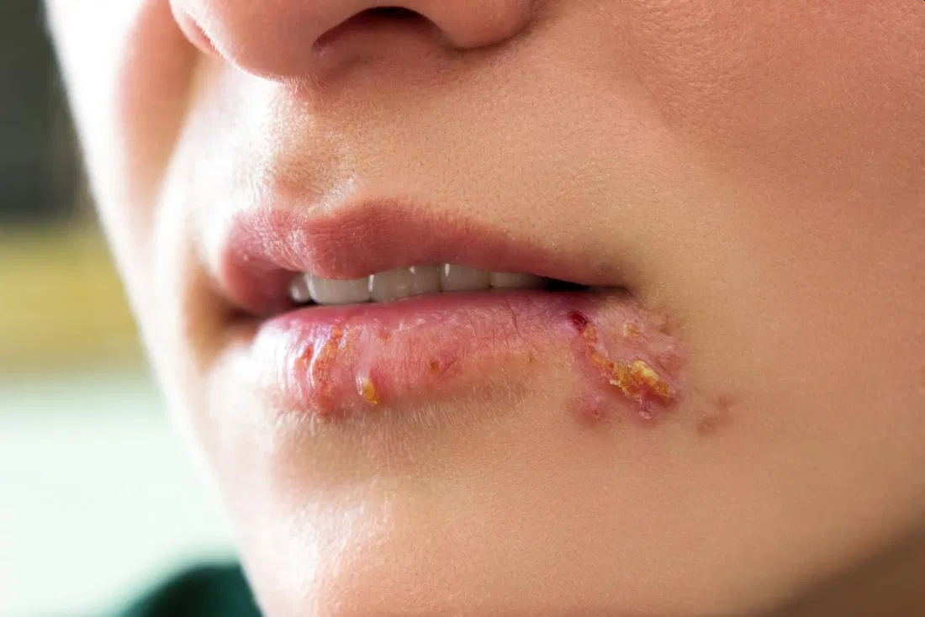
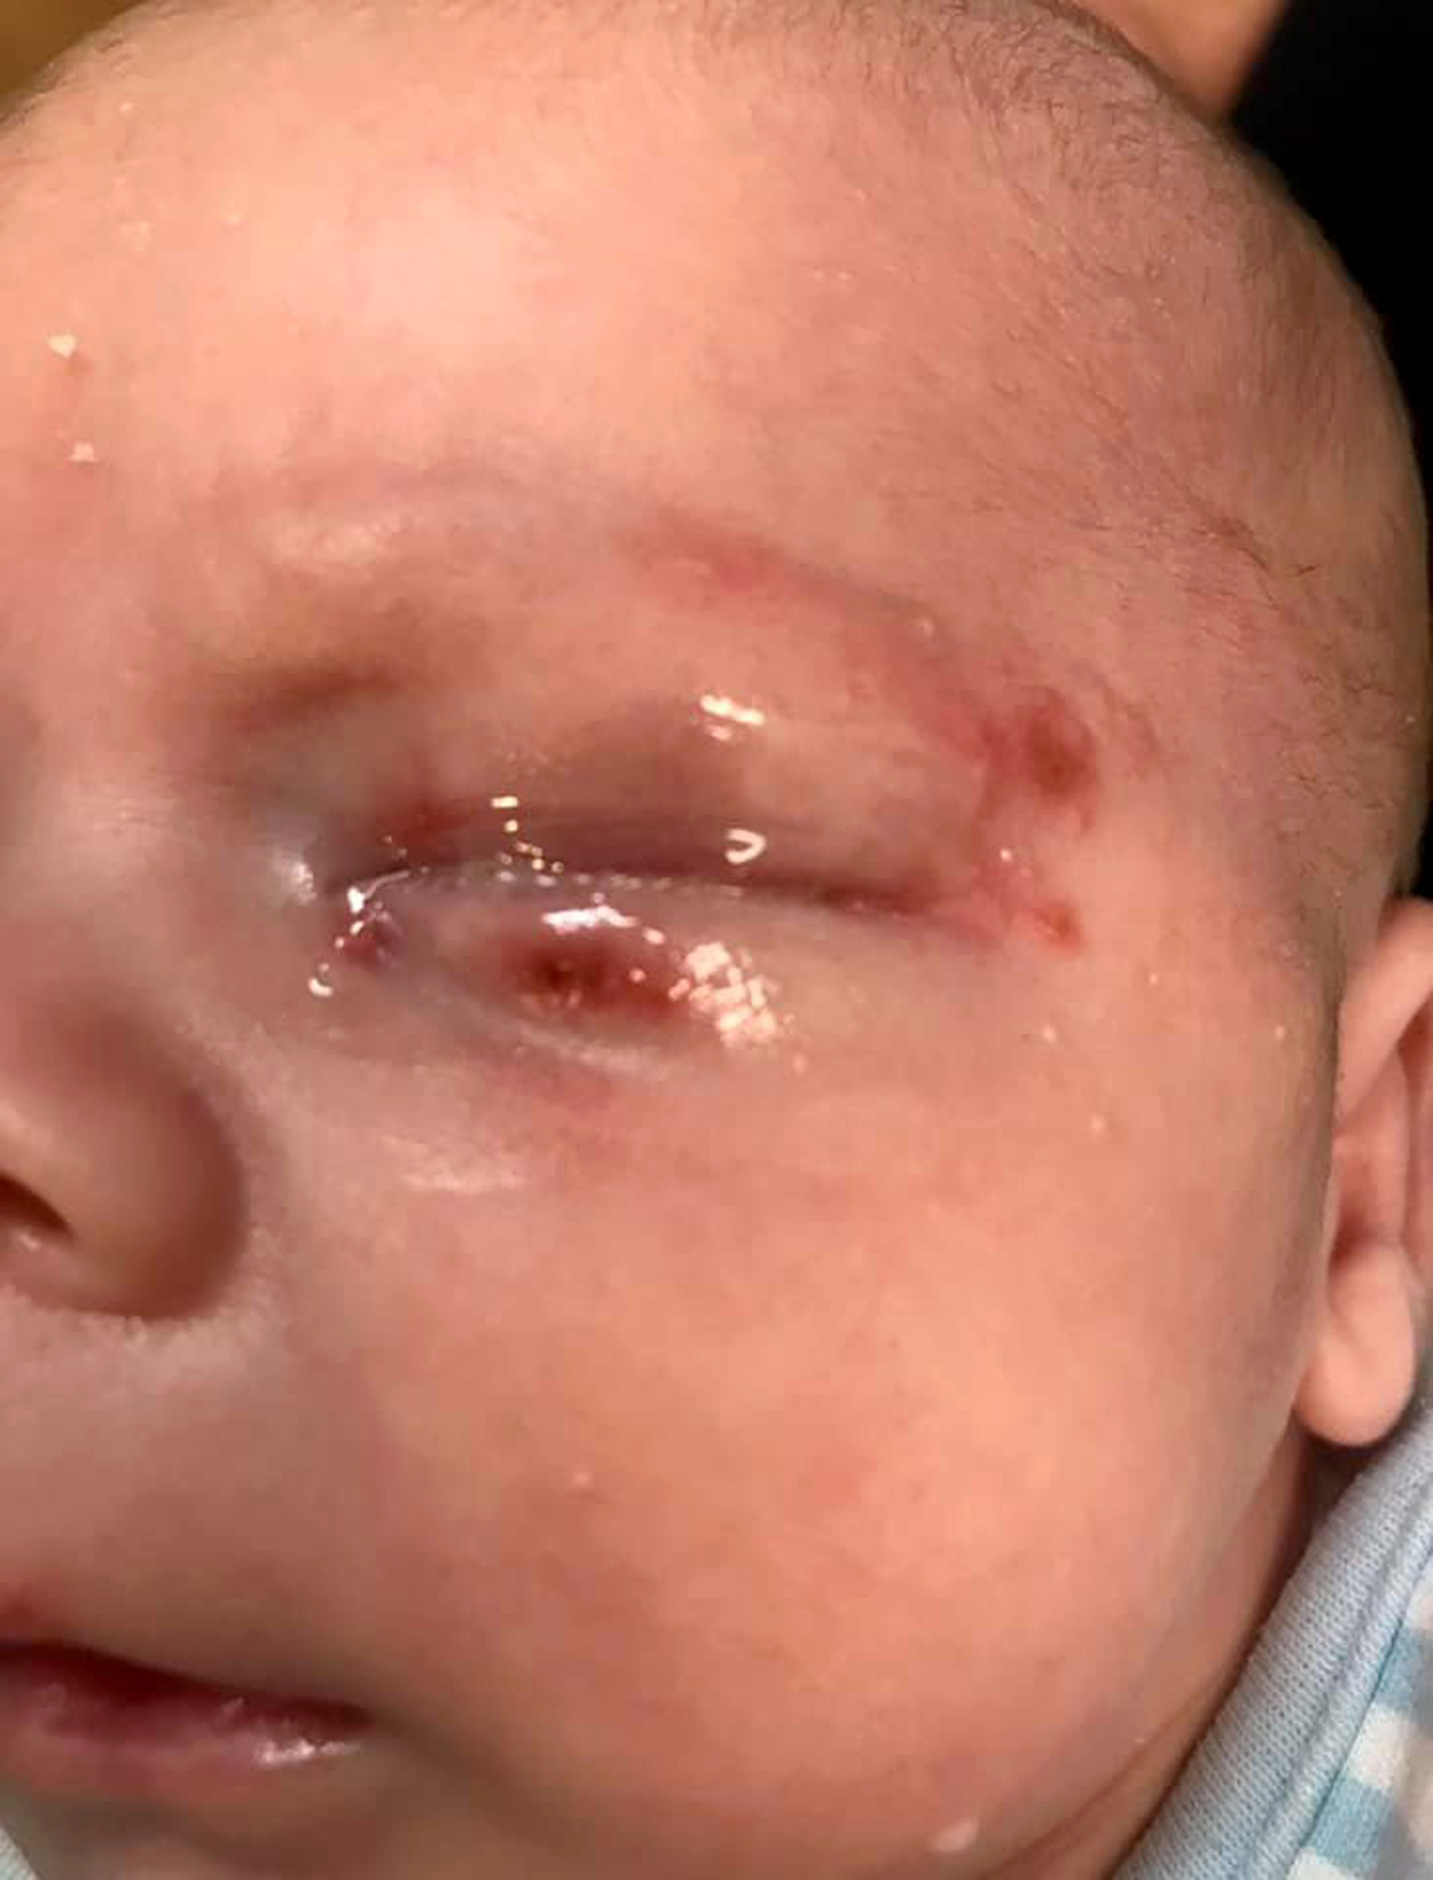
Requirement 1b
Herpes
Type or Form | Virus
Method of Transmission or Vectors | Sexually transmitted disease (STD). Maternal to infant. No animal vectors.
Methods of Prevention | Abstinence. Safe sex.
Available Treatments | No cure. Antivirals to control outbreaks.

Slide 42
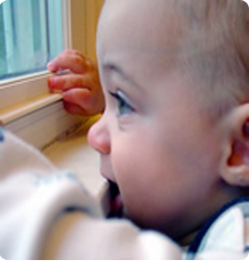
Requirement 1b
Lead Poisoning
Type or Form | Environmental
Method of Transmission or Vectors | Environmental exposure (usually ingestion by infants/toddlers). No animal vectors.
Methods of Prevention | Environmental monitoring. Abatement (Eliminate and remove lead based paint). Identification of “at risk” persons.
Available Treatments | Chelation therapy
Lead Paint

Slide 43
Requirement 2
Do the following:
Explain the meaning of immunization.
Name eight diseases against which a young child should be immunized, two diseases against which everyone should be re-immunized periodically, and one immunization everyone should receive annually.
Using the list of diseases and conditions in requirement 1b, discuss with your counselor those which currently have no immunization available.

Slide 44
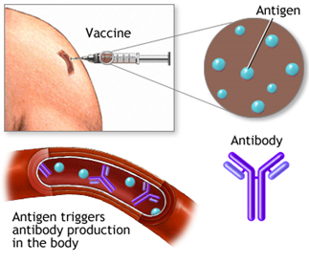
Requirement 2a
Immunization is the process whereby a person is made immune or resistant to an infectious disease, typically by the administration of a vaccine.
Vaccines stimulate the body's own immune system to protect the person against subsequent infection or disease.

Slide 45
Requirement 2
Do the following:
Explain the meaning of immunization.
Name eight diseases against which a young child should be immunized, two diseases against which everyone should be re-immunized periodically, and one immunization everyone should receive annually.
Using the list of diseases and conditions in requirement 1b, discuss with your counselor those which currently have no immunization available.

Slide 46
Requirement 2b
Recommended Immunization Schedule 2020

Slide 47
Requirement 2b

Slide 48
Requirement 2
Do the following:
Explain the meaning of immunization.
Name eight diseases against which a young child should be immunized, two diseases against which everyone should be re-immunized periodically, and one immunization everyone should receive annually.
Using the list of diseases and conditions in requirement 1b, discuss with your counselor those which currently have no immunization available.

Slide 49
Requirement 2c
Diseases for which there is currently no vaccine.
Gonorrhea
West Nile Virus
Zika
Botulism
Syphilis
Emphysema
Herpes
Lead Poisoning

Slide 50
Requirement 3
Discuss the importance of safe drinking water in terms of the spread of disease. Then, demonstrate two ways for making water safe to drink that can be used while at camp. In your demonstration, explain how dishes and utensils should be washed, dried, and kept sanitary at home and in camp.

Slide 51
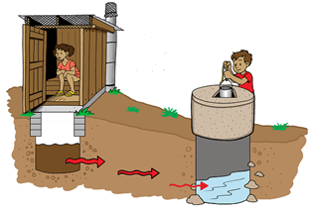
Requirement 3
Contaminated water can transmit diseases such as cholera, dysentery, typhoid, and polio, and is estimated to cause 485,000 diarrheal deaths in the world each year.
Over the last 100 years, many improvements in the health, success, and lifespan of the U.S. population can be linked to improvements in water quality.
Water treatment and disinfection was one of the most important public health achievements in the U.S. of the 20th century and have helped ensure access to healthy and safe water for millions of Americans.

Slide 52
Requirement 3

Slide 53
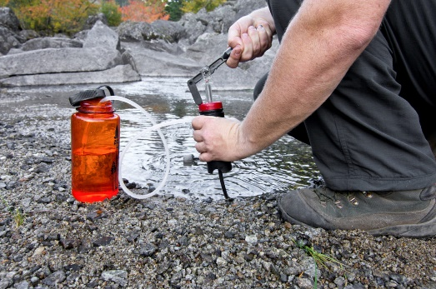
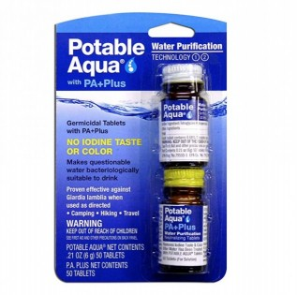
Requirement 3
The water in lakes, rivers, and springs may look crystal clear but often contains various bacteria that can cause illness.
Three purification methods:
Filters: Simply pump water from the source with a water filter into a container. The filter mechanically removes protozoa and bacteria.
Chemical tablets: Water purification tablets, such as Potable Aqua, are a second option. They employ chemicals, usually iodine, to kill harmful bacteria.
Boiling: Bringing water to a rolling boil is a third option.

Slide 54
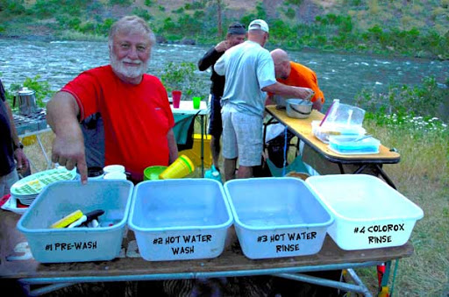
Requirement 3
Washing Dishes While Camping
Prewash: Is for getting the waste off of the dishes.
Hot Water Wash: Using as little soap as possible, the dishes are washed. The cleanest dishes go first, the dirtiest dishes go last.
Hot Water Rinse: Rinse dishes in hot water.
Sanitizing Soak: dip dishes in a chlorine and water rinse to kill bacteria. Use 1 tablespoon of bleach to 1 gallon of water for your rinse. Allow utensils to remain for 45 seconds in the rinse.
The utensils should be air dried and then covered or put away once dry.

Slide 55
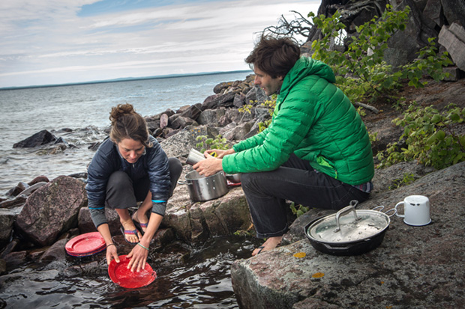
Requirement 3
How NOT to wash dishes while camping!!

Slide 56
Requirement 3
Washing Dishes at Home
Step One: Scrape food off surfaces before washing.
Step Two: Wash the dishes in hot, soapy water. Be sure to use clean dishcloths each day and don’t use sponges! They tend to harbor germs.
Step Three: Rinse dishes very thoroughly in clean, hot water. You want all the soap removed because soap that makes its way into your chlorine bleach solution in Step 4 stops the bleach from sanitizing.
Step Four: Sanitize the dishes with a chlorine bleach solution. Soak dishes for at least 45 seconds in a sanitizing solution made up of 1 tablespoon of unscented chlorine bleach + 1 gallon of cool water.
Step Five: Allow dishes to air dry. Don’t dry with a cloth or towel; this can spread germs.

Slide 57
Requirement 4
Explain what a vector is and how insects and rodents can be controlled in your home, in your community, and at camp. Tell why this is important. In your discussion, explain which vectors can be easily controlled by individuals and which ones require long-term, collective action.

Slide 58
Requirement 4
A disease vector is an organism that does not cause a disease, but transmits an infection by conveying pathogens from one host to another, serving as a route of transmission.

Slide 59
Requirement 4
Vector control focuses on utilizing preventive methods to control or eliminate vector populations. Common preventive measures are:
Habitat and environmental control
Removing or reducing areas where vectors can easily breed can help limit their growth.
Both individuals and communities can undertake stagnant water removal, destruction of old tires and cans which serve as mosquito breeding environment.
Both individuals and communities can reduce the presence of garbage to reduce the incidence of flies and rodents acting as vectors to spread diseases.
Both individuals and communities can reduce the presence of human/animal (pet) feces to reduce the incidence of flies acting as vectors to spread diseases.

Slide 60
Requirement 4
Vector control focuses on utilizing preventive methods to control or eliminate vector populations. Common preventive measures are:
Reducing contact
Limiting exposure to insects or animals that are known disease vectors can reduce the likelihood of contact with vectors reducing infection risks significantly.
The individual can use screens on homes or tents and wear protective clothing when outside, to reduce the likelihood of contact with insect vectors.
Eliminate entry points that rodents can use to enter the home.

Slide 61
Requirement 4
Vector control focuses on utilizing preventive methods to control or eliminate vector populations. Common preventive measures are:
Chemical control
Larvicides can be used in mosquito breeding zones through community programs.
Insecticides can be applied both around the home and community.
Individuals using insect repellents can reduce insect and tick bites and thus infection.
Both individuals and communities can use rodenticides (rat poison) to control mice and rats.
Biological control
The use of natural vector predators by government agencies can help control vector populations.
Using fish that eat mosquito larvae,.

Slide 62
Requirement 5
With your parent's and counselor's approval, do ONE of the following:
Visit a municipal wastewater treatment facility OR a solid-waste management operation in your community.
Describe how the facility safely treats and disposes of sewage or solid waste.
Discuss your visit and what you learned with your counselor.
Describe how sewage and solid waste should be disposed of under wilderness camping conditions.
Visit a food service facility, such as a restaurant or school cafeteria.
Observe food preparation, handling, and storage. Learn how the facility keeps food from becoming contaminated.
Find out what conditions allow micro-organisms to multiply in food, what can be done to help prevent them from growing and spreading, and how to kill them.
Discuss the importance of using a thermometer to check food temperatures.
Discuss your visit and what you learned with your counselor.

Slide 63
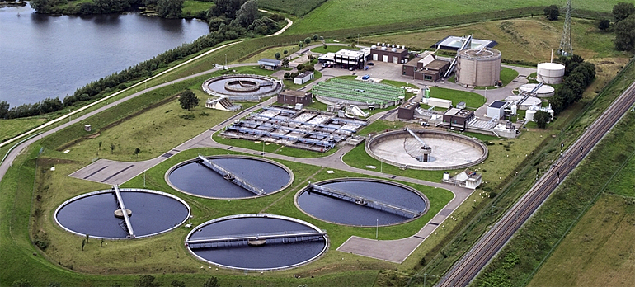
Requirement 5a1
Take a virtual tour of a Wastewater Treatment Plant.

Slide 64
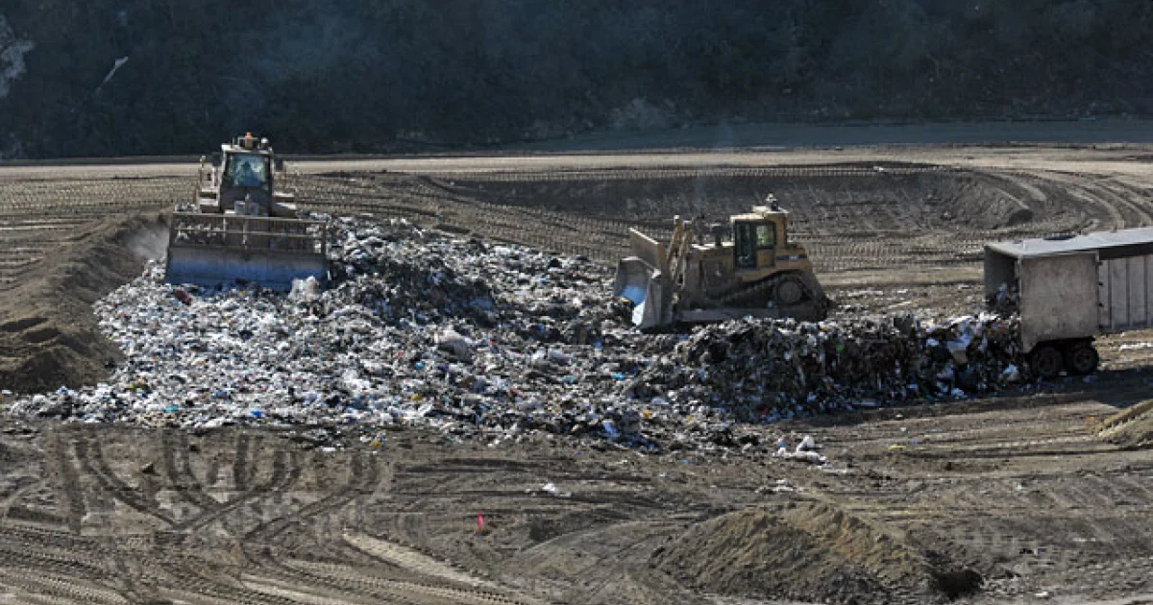
Requirement 5a1
Take a virtual tour of a Solid Waste Management Facility.

Slide 65
Requirement 5
With your parent's and counselor's approval, do ONE of the following:
Visit a municipal wastewater treatment facility OR a solid-waste management operation in your community.
Describe how the facility safely treats and disposes of sewage or solid waste.
Discuss your visit and what you learned with your counselor.
Describe how sewage and solid waste should be disposed of under wilderness camping conditions.
Visit a food service facility, such as a restaurant or school cafeteria.
Observe food preparation, handling, and storage. Learn how the facility keeps food from becoming contaminated.
Find out what conditions allow micro-organisms to multiply in food, what can be done to help prevent them from growing and spreading, and how to kill them.
Discuss the importance of using a thermometer to check food temperatures.
Discuss your visit and what you learned with your counselor.

Slide 66
Requirement 5a3
How sewage and solid waste should be disposed of under wilderness camping conditions.
Human Waste
Cat holes are the most widely accepted method of waste disposal.
Locate cat holes at least 200 feet (about 70 adult paces) from water, trails and camp.
Select an inconspicuous site where other people will be unlikely to walk or camp.
With a small garden trowel, dig a hole 6-8 inches deep and 4-6 inches in diameter.
The cat hole should be covered and disguised with natural materials when finished.

Slide 67
Requirement 5a3
How sewage and solid waste should be disposed of under wilderness camping conditions.
Other Forms of Waste
“Pack it in, Pack it out” is a familiar mantra to seasoned wildland visitors.
Any user of recreation lands has a responsibility to clean up before he or she leaves.
Inspect your campsite and rest areas for trash or spilled foods.
Pack out all trash and garbage in resealable plastic bags and dispose of properly when off of the trail.

Slide 68
Requirement 5
With your parent's and counselor's approval, do ONE of the following:
Visit a municipal wastewater treatment facility OR a solid-waste management operation in your community.
Describe how the facility safely treats and disposes of sewage or solid waste.
Discuss your visit and what you learned with your counselor.
Describe how sewage and solid waste should be disposed of under wilderness camping conditions.
Visit a food service facility, such as a restaurant or school cafeteria.
Observe food preparation, handling, and storage. Learn how the facility keeps food from becoming contaminated.
Find out what conditions allow micro-organisms to multiply in food, what can be done to help prevent them from growing and spreading, and how to kill them.
Discuss the importance of using a thermometer to check food temperatures.
Discuss your visit and what you learned with your counselor.

Slide 69
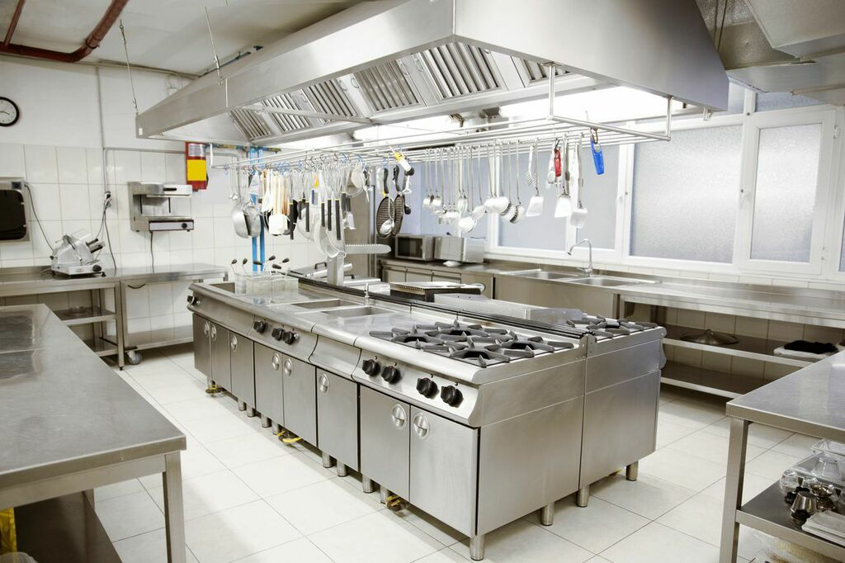
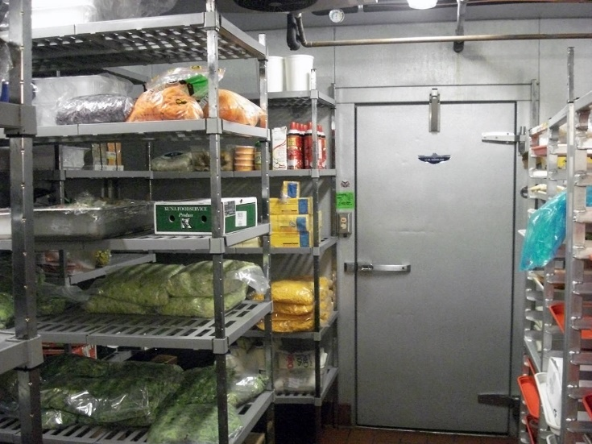
Requirement 5b
Take a virtual tour of an inspection of a Food Service Facility.

Slide 70
Requirement 6
Do the following:
Describe the health dangers from air, water, and noise pollution.
Describe health dangers from tobacco use and alcohol and drug abuse.
Describe the health dangers from abusing illegal and prescription drugs.

Slide 71
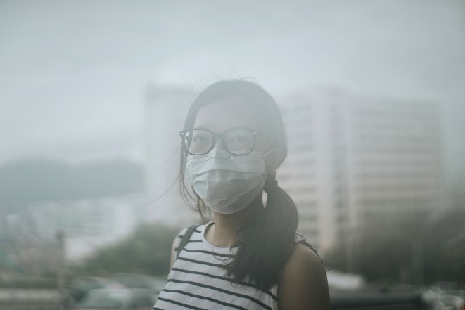
Requirement 6a
Health Dangers from Air Pollution
Accelerated aging of the lungs.
Loss of lung capacity and decreased lung function.
Development of diseases such as asthma, bronchitis, emphysema, and possibly cancer.
Shortened life span.

Slide 72
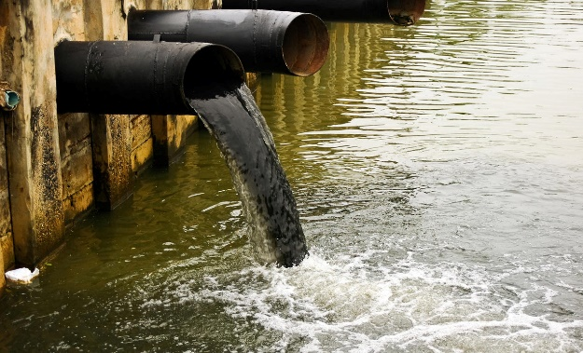
Requirement 6a
Health Dangers from Water Pollution
Infectious diseases can be spread through contaminated water.
Some of these water-borne diseases are Typhoid, Cholera, Paratyphoid Fever, Dysentery, Jaundice, Amoebiasis and Malaria.

Slide 73
Requirement 6a
Health Dangers from Water Pollution
Chemicals in the water also have negative effects on our health.
Pesticides – can damage the nervous system and cause cancer because of the carbonates and organophosphates that they contain. Chlorides can cause reproductive and endocrinal damage.
Nitrates – are especially dangerous to babies that drink formula milk. It restricts the amount of oxygen in the brain and cause the “blue baby” syndrome.
Lead – can accumulate in the body and damage the central nervous system.
Arsenic – causes liver damage, skin cancer and vascular diseases
Fluorides - in excessive amounts can make your teeth yellow and cause damage to the spinal cord.
Petrochemicals – even with very low exposure, can cause cancer.

Slide 74
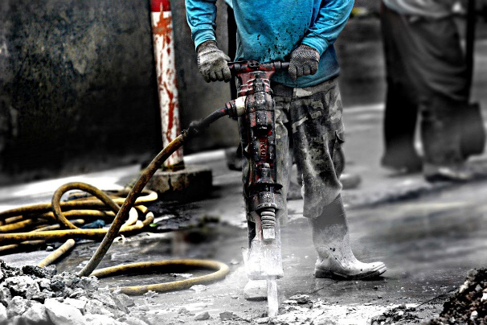
Requirement 6a
Health Dangers from Noise Pollution
Loud sounds can damage sensitive structures of the inner ear and cause hearing loss.
Exposure to noise causes adverse health effects like stress, anxiety, depression, high blood pressure, and heart disease.

Slide 75
Requirement 6
Do the following:
Describe the health dangers from air, water, and noise pollution.
Describe health dangers from tobacco use and alcohol and drug abuse.
Describe the health dangers from abusing illegal and prescription drugs.

Slide 76
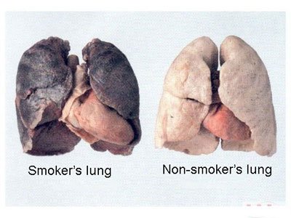
Requirement 6b
Health Dangers from Tobacco Use.
Smoking causes cancer, heart disease, stroke, lung diseases, diabetes, and chronic obstructive pulmonary disease (COPD), which includes emphysema and chronic bronchitis.
Chewing tobacco use is a risk factor for the development of oral cancers and pre-cancers.
Other health risks of chewing tobacco include gum disease, tooth decay and tooth loss, and possible links to other cancers and cardiovascular disease.

Slide 77
Requirement 6b
Health Dangers from Alcohol Abuse.
High blood pressure, heart disease, stroke, liver disease, and digestive problems.
Cancer of the breast, mouth, throat, esophagus, liver, and colon.
Weakening of the immune system, increasing the chances of getting sick.
Learning and memory problems, including dementia and poor school performance.
Mental health problems, including depression and anxiety.
Social problems, including lost productivity, family problems, and unemployment.
Alcohol dependence, or alcoholism.

Slide 78
Requirement 6
Do the following:
Describe the health dangers from air, water, and noise pollution.
Describe health dangers from tobacco use and alcohol and drug abuse.
Describe the health dangers from abusing illegal and prescription drugs.

Slide 79
Requirement 6c
Health Dangers from Abusing Illegal and Prescription Drugs.
Nausea and abdominal pain, which can also lead to changes in appetite and weight loss.
Increased strain on the liver, which puts the person at risk of significant liver damage or liver failure.
Seizures, stroke, mental confusion and brain damage.
Lung disease.
Problems with memory, attention and decision-making, which make daily living more difficult.
A weakened immune system, increasing the risk of illness and infection.
Heart conditions ranging from abnormal heart rates to heart attacks and collapsed veins and blood vessel infections from injected drugs.

Slide 80
Requirement 7
With your parent's and counselor's approval, do ONE of the following:
Visit your city, county, or state public health agency.
Familiarize yourself with your city, county, or state health agency's website.

Slide 81
Requirement 7a
Contact information to set up a visit:
Wood County Health Department 1840 East Gypsy Lane Rd. Bowling Green, OH 43402
419-352-8402

Slide 82
Requirement 7
With your parent's and counselor's approval, do ONE of the following:
Visit your city, county, or state public health agency.
Familiarize yourself with your city, county, or state health agency's website.

Slide 83
Requirement 7b
Click on the link to visit the Wood County Health Department website.

Slide 84
Requirement 8
After completing either 7a or 7b, do the following:
Compare the four leading causes of mortality (death) in your community for any of the past five years with the four leading causes of disease in your community. Explain how the public health agency you visited is trying to reduce the mortality and morbidity rates of these leading causes of illness and death.
Explain the role of your health agency as it relates to the outbreak of diseases.
Discuss the kinds of public assistance the agency is able to provide in case of disasters such as floods, storms, tornadoes, earthquakes, and other acts of destruction. Your discussion can include the cleanup necessary after the disaster.

Slide 85
Requirement 8a
Leading causes of death in Wood County, OH for 2018.
Heart Disease (26% of all deaths)
Cancer (22%)
Chronic Lower Respiratory Diseases (7%)
Stroke (6%)
Alzheimer’s Disease (5%)

Slide 86
Requirement 8a
Leading chronic diseases in Wood County, OH for 2018.
Cardiovascular Disease - 39% of adults had major risk factors for developing cardiovascular disease.
Arthritis - 28% of adults were diagnosed with arthritis.
Asthma - 15% of adults had been diagnosed with asthma.
Cancer - 14% of adults were diagnosed with cancer at some point in their lives.
Diabetes - 8% of adults had been diagnosed with diabetes.

Slide 87
Requirement 8a
Explain how the public health agency you visited is trying to reduce the mortality and morbidity rates of these leading causes of illness and death.
Explain the role of your health agency as it relates to the outbreak of diseases.
Discuss the kinds of public assistance the agency is able to provide in case of disasters such as floods, storms, tornadoes, earthquakes, and other acts of destruction. Your discussion can include the cleanup necessary after the disaster.
Contact the Wood County Health Department for this information.
Wood County Health Department 1840 East Gypsy Lane Rd. Bowling Green, OH 43402
419-352-8402

Slide 88
Requirement 9
Pick a profession in the public health sector that interests you. Find out the education, training, and experience required to work in this profession. Discuss what you learn with your counselor.

Slide 89
Requirement 9
Careers in Public Health typically require a bachelors degree, although some may require a masters or doctorate degree.
Biostatistics & Informatics
Communications
Community Health
Emergency Management
Environmental Health
Epidemiologists
Maternity and Child Health
Medical Practice
Mental Health
Public Health Education
Sanitarians
Social and Behavioral Health

